Slide 1
SCU Collab
Kevin Cai and Wesley Sha
Computer Science and Engineering
SCHOOL OF ENGINEERING

Slide 2
Introduction
Collaborative learning is a useful resource for students
  Conflicting schedules can make it difficult for students to schedule meetings or work together
Current solutions
  Students can use social media as a platform for discussion
    Can be distracting due recreational nature of social media platforms
  Sites such as Camino can also be used
    Discussion boards are rarely used unless required
We propose a portable application that focuses on collaboration
SCHOOL OF ENGINEERING

Slide 3
Requirements
Functional
The system will…
  allow users to set up accounts
  allow users to create and join groups
  allow users to set meeting dates
  provide a forum for discussion
  notify user of events
SCHOOL OF ENGINEERING

Slide 4
Requirements
Nonfunctional
The system will be…
  secure
  user-friendly
  intuitive
SCHOOL OF ENGINEERING

Slide 5
Requirements
Design Constraints
Be able to run on both iOS and Android
SCHOOL OF ENGINEERING

Slide 6
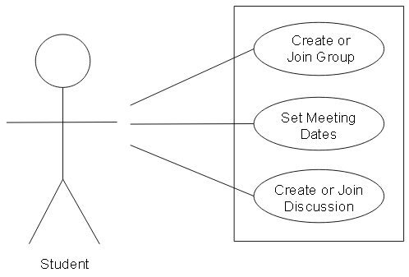
Use Cases
SCHOOL OF ENGINEERING

Slide 7
Use Case: Create or join group
Actor: Student
Pre-condition: User must be logged in
Post-condition: Group is created or joined
Steps:
  Select “Create a Group” or “Join a Group”
  Select a group name
  Enter the group key
SCHOOL OF ENGINEERING

Slide 8
Use Case: Set meeting dates
Actor: Student
Pre-condition: User must be a member of a group
Post-condition: Meeting date is set and marked on calendar
Steps:
  Select “Meetings”
  Create or join an event
SCHOOL OF ENGINEERING

Slide 9
Use Case: Create or join a discussion
Actor: Student
Pre-condition: User must be a member of a group
Post-condition: User will be able to view and post responses in discussion
Steps:
  Select a group page
  Select the forum page
  View and respond to existing discussions, or start their own
SCHOOL OF ENGINEERING

Slide 10
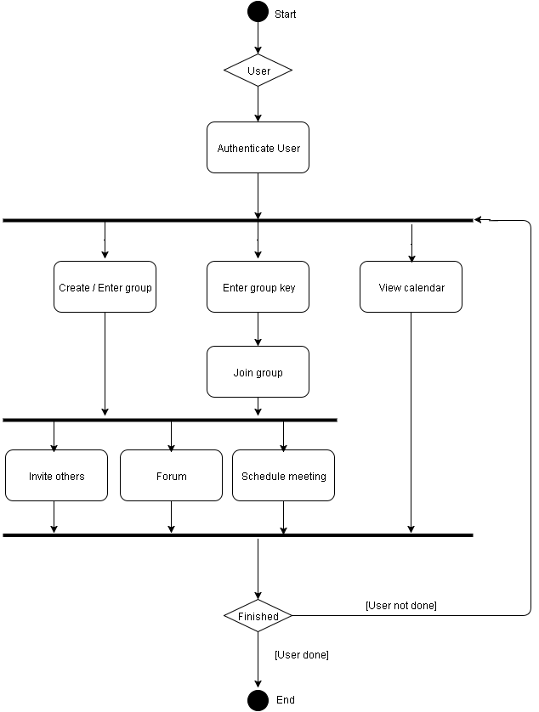
Activity Diagram
SCHOOL OF ENGINEERING

Slide 11
Technologies
HTML, CSS, Javascript
  Page structure, styling, and functionality
MySQL/PHP
  Database system and scripting language
Phonegap
  Framework for creating hybrid apps
SCHOOL OF ENGINEERING

Slide 12
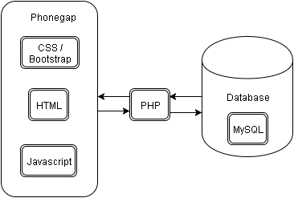
Architectural Design
SCHOOL OF ENGINEERING

Slide 13
Design Rationale
Simple, clean interface
  Main page to create or join groups
  Sidebar to manage navigation
  Manage space to minimize clutter
Popular web technologies
  Works with most common OSs
  Well documented
SCHOOL OF ENGINEERING

Slide 14
Demonstration
SCHOOL OF ENGINEERING

Slide 15
Testing Plan
Thoroughly test each feature in the application
  Create multiple test accounts
  Create and join multiple groups
  Check calendar of events
  Make posts on forum
Allow other students to test
Modify system based on feedback
SCHOOL OF ENGINEERING

Slide 16
Risk Analysis
Risk | Consequences | Probability (0-1) | Severity (0-10) | Impact (Prob * Sev) | Mitigation Strategy
Bugs | Program does not work properly | 0.7 | 7 | 4.9 | Test for bugs early and often Address bugs as soon as possible
Unfamiliar with technology | Delays Unable to meet requirements | 0.7 | 7 | 4.9 | Work on or ahead of schedule Practice
Changing requirements | New features needed | 0.2 | 5 | 1.0 | Maintain code flexibility Code well
Loss of Data | Modules will have to be rebuilt | 0.1 | 9 | 0.9 | Backups Version control systems
SCHOOL OF ENGINEERING

Slide 17
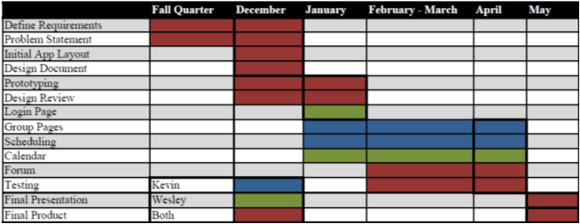
Development Timeline
SCHOOL OF ENGINEERING

Slide 18
Thank you!
Questions?
SCHOOL OF ENGINEERING

Slide 19
Risk Analysis
Risk | Consequences | Probability (0-1) | Severity (0-10) | Impact (Prob. * Sev.) | Mitigation Strategy
Bugs | Unable to meet requirements Program does not work properly | 0.7 | 7 | 4.9 | Test for bugs early and often Attend to bugs as soon as possible
Unfamiliar with technologies | Delays Unable to meet requirements | 0.7 | 7 | 4.9 | Work ahead of schedule Practice
Changing Requirements | New features are needed | 0.2 | 5 | 1.0 | Maintain code flexibility Comment well
Loss of data | Modules will have to be rebuilt | 0.1 | 9 | 0.9 | Backups Version control systems
SCHOOL OF ENGINEERING

Slide 20
Title: Aerial Bold 28 pt.; Title Case
Subtitle: Arial bold italic 22 pt.; sentence style
Body: Arial narrow bold 24 pt.; bullet: Webdings;
sentence case
  Sub-bullets: Arial Narrow 20 pt.; Bullet: Webdings;
    Second sub-bullet
    Third sub-bullet
SCHOOL OF ENGINEERING

Slide 21
Section Title: Arial Bold 32 pt.
SCHOOL OF ENGINEERING

Slide 22
Bullet Format
Use “smart” quotes
Fiscal years should be formatted as FY ’01
Highlight in this color for overheads
Hyperlink: www.scu.edu
Correct dashes used: -, –, —
SCHOOL OF ENGINEERING

Slide 23
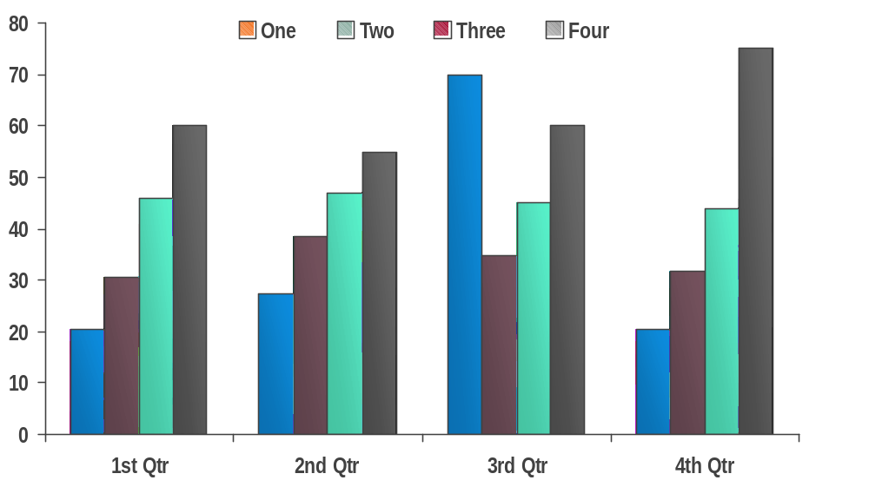
Chart Example
Source: Placeholder for notes, etc. 14 pt..
SCHOOL OF ENGINEERING

Slide 24
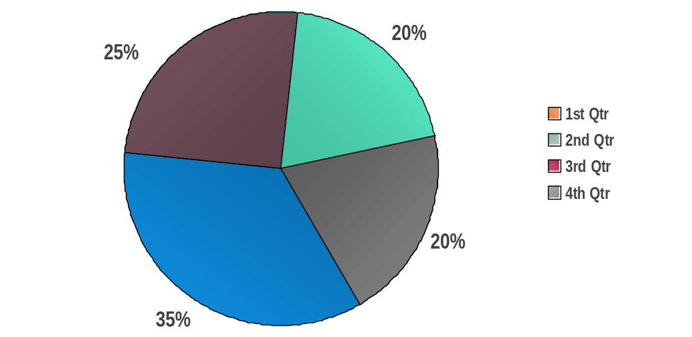
Pie Chart Example
Source: Placeholder for notes, etc. 14 pt..
SCHOOL OF ENGINEERING

Slide 25
Table Example
 | 1st Qtr | 2nd Qtr | 3rd Qtr | 4th Qtr
Secure 1 |  |  |  | 
Secure 2 |  |  | 
Secure 3 |  |  |  | 
Secure 4 |  |  |  | 
Secure 5 |  |  |  | 
Secure 6 |  |  | 
Secure 7 |  |  |  | 
Source: Placeholder for notes, etc. 14 pt..
SCHOOL OF ENGINEERING

Slide 26
Text with Graphic on Right
Large Label
Body: Arial narrow bold 24 pt.; bullet: Webdings;
sentence case
  Sub-bullets: Arial Narrow 20 pt.; Bullet: Webdings;
    Second sub-bullet
    Third sub-bullet
Small Label
Small Label
SCHOOL OF ENGINEERING

Slide 27
Sample Quote
“When a billion wireless phones wake up in
the next few years, a distributed architecture
will be the only way people will be able to
receive the information they need.”
Anonymous
Title
Company
SCHOOL OF ENGINEERING

Slide 28
Color Palette
Primary colors
Highlights
Solid
white
text
white
text
black
text
black
text
white
text
white
text
white
text
black
text
white
text
201
452
124
415
5565
201
1665
124
201
Use this style for PPT objects
(To apply this style to an object use the “format painter”)
SCHOOL OF ENGINEERING

Slide 29
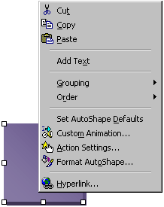
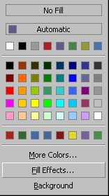
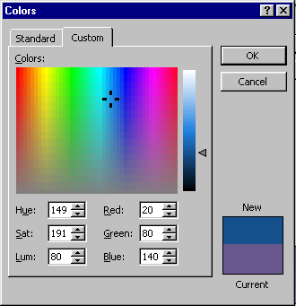
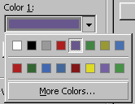
How To Apply Different Colors To Objects
Use this way if you don’t see a color you want to use from the “Graphics Elements” slide
Step 1
Step 2
Step 3
Step 4
Final Result
Right mouse click on the object you want to change and select “Format AutoShape” from the pop-up
Click on the “Color” pop-up and select “Fill Effects”
Select
“More Colors”
Select the new
color you want and click “OK”
SCHOOL OF ENGINEERING

Slide 30
Slide Transitions
All slides: “wipe right”
SCHOOL OF ENGINEERING

Slide 31
Out-of-Bounds
Graphics and text should not extend into this red area
SCHOOL OF ENGINEERING

